Slide 1
OpenEDR Registry Spy

Slide 2



OUR TEAM
Nguyễn Bình Thục Trâm
Võ Anh Kiệt
Nguyễn Bùi
Kim Ngân
20520815
20520605
20520648

Slide 3
Table of contents
01
02
EDR - OpenEDR
Registry Spy

Slide 4
01
EDR – Endpoint Detect Respone OpenEDR

Slide 5

OpenEDR
Open EDR is a sophisticated, free, open-source endpoint detection and response solution. It provides analytic detection with Mitre ATT&CK visibility for event correlation and root cause analysis of adversarial threat activity and behaviors in real time.
This world-class endpoint telemetry platform is available to all cyber-security professionals, and every sized organization, to defend against threat actors and cyber criminals.

Slide 6
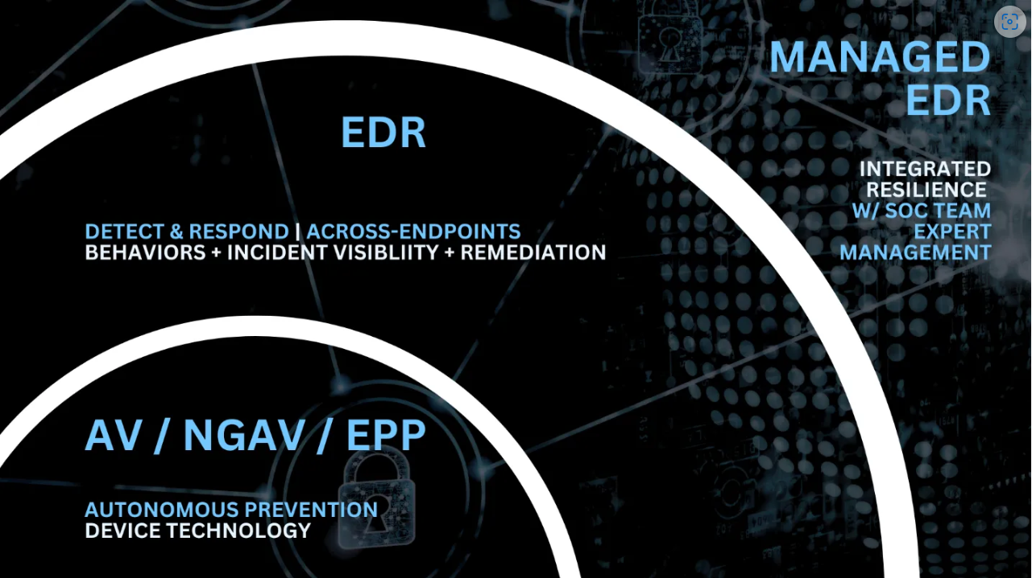
OpenEDR

Slide 7
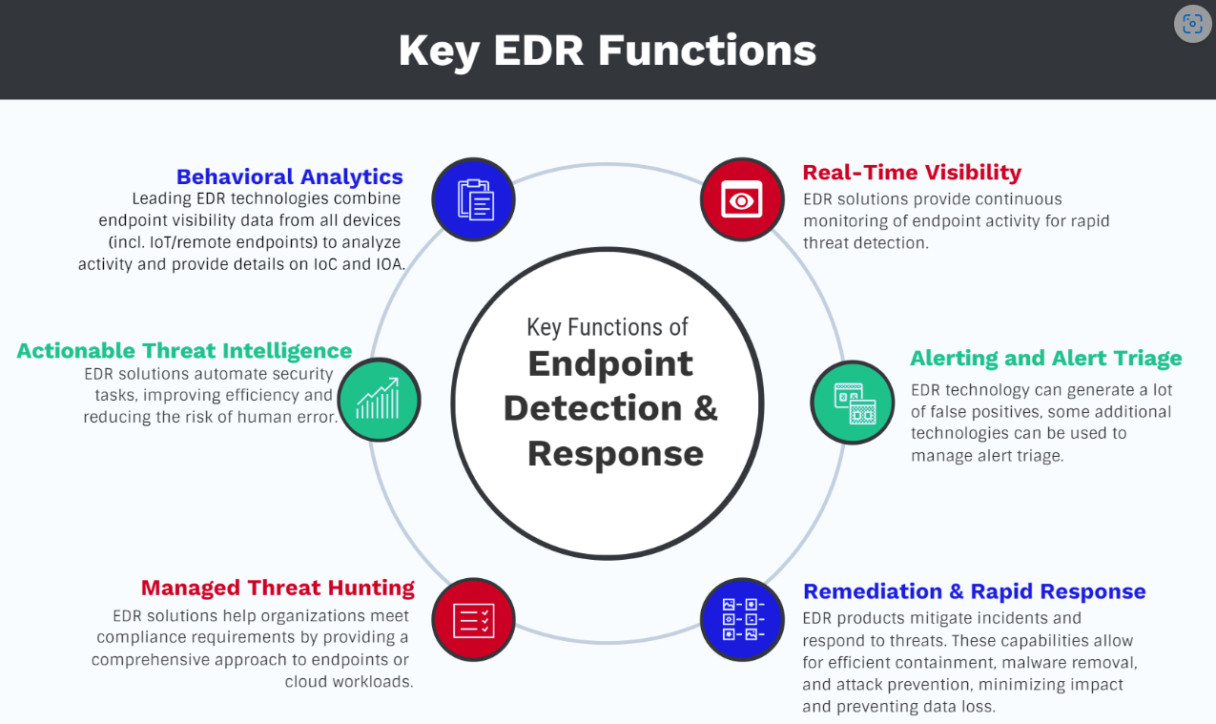
OpenEDR

Slide 8
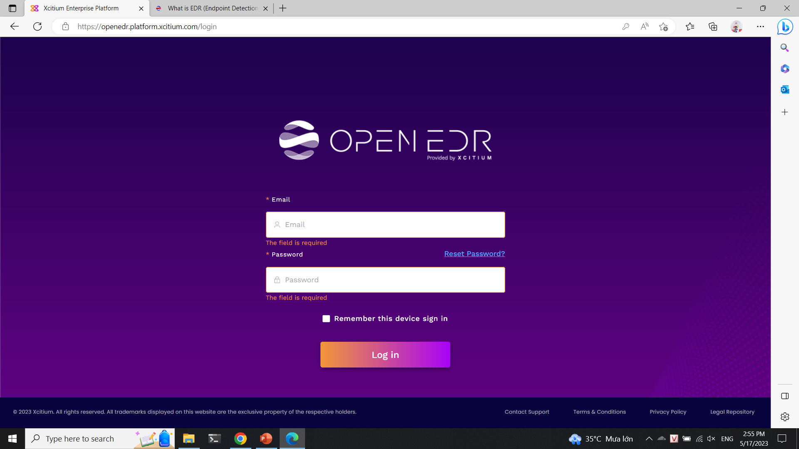
Installation

Slide 9
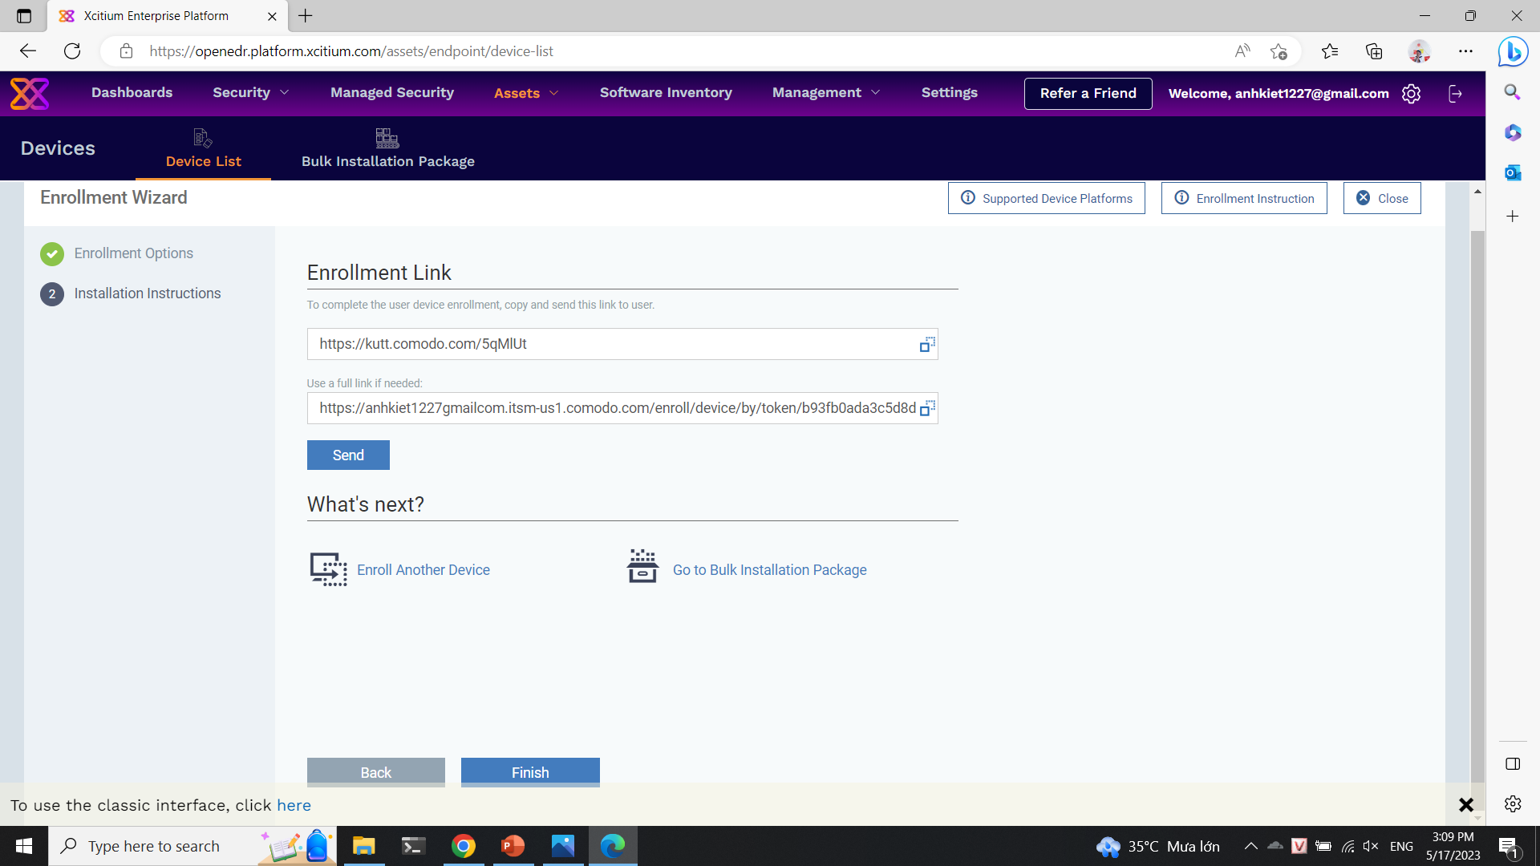
Installation Agent

Slide 10
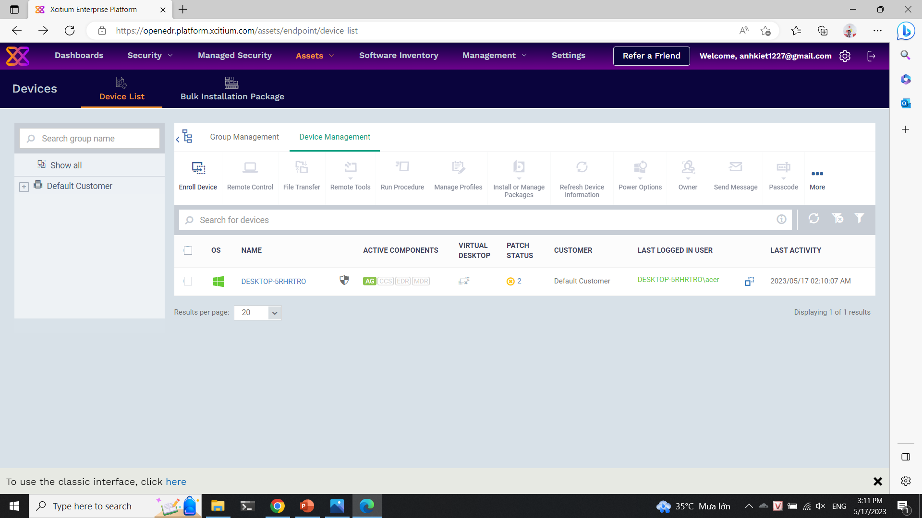
Installation Agent

Slide 11
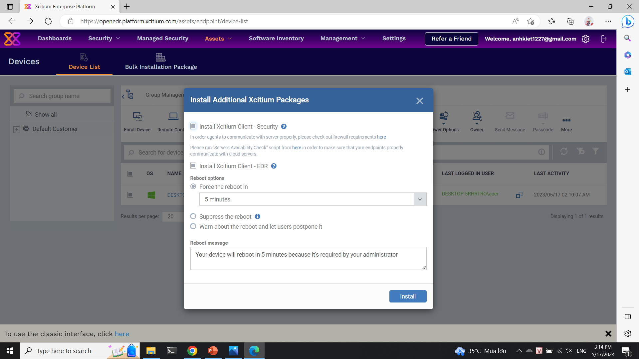
Installation Packages

Slide 12
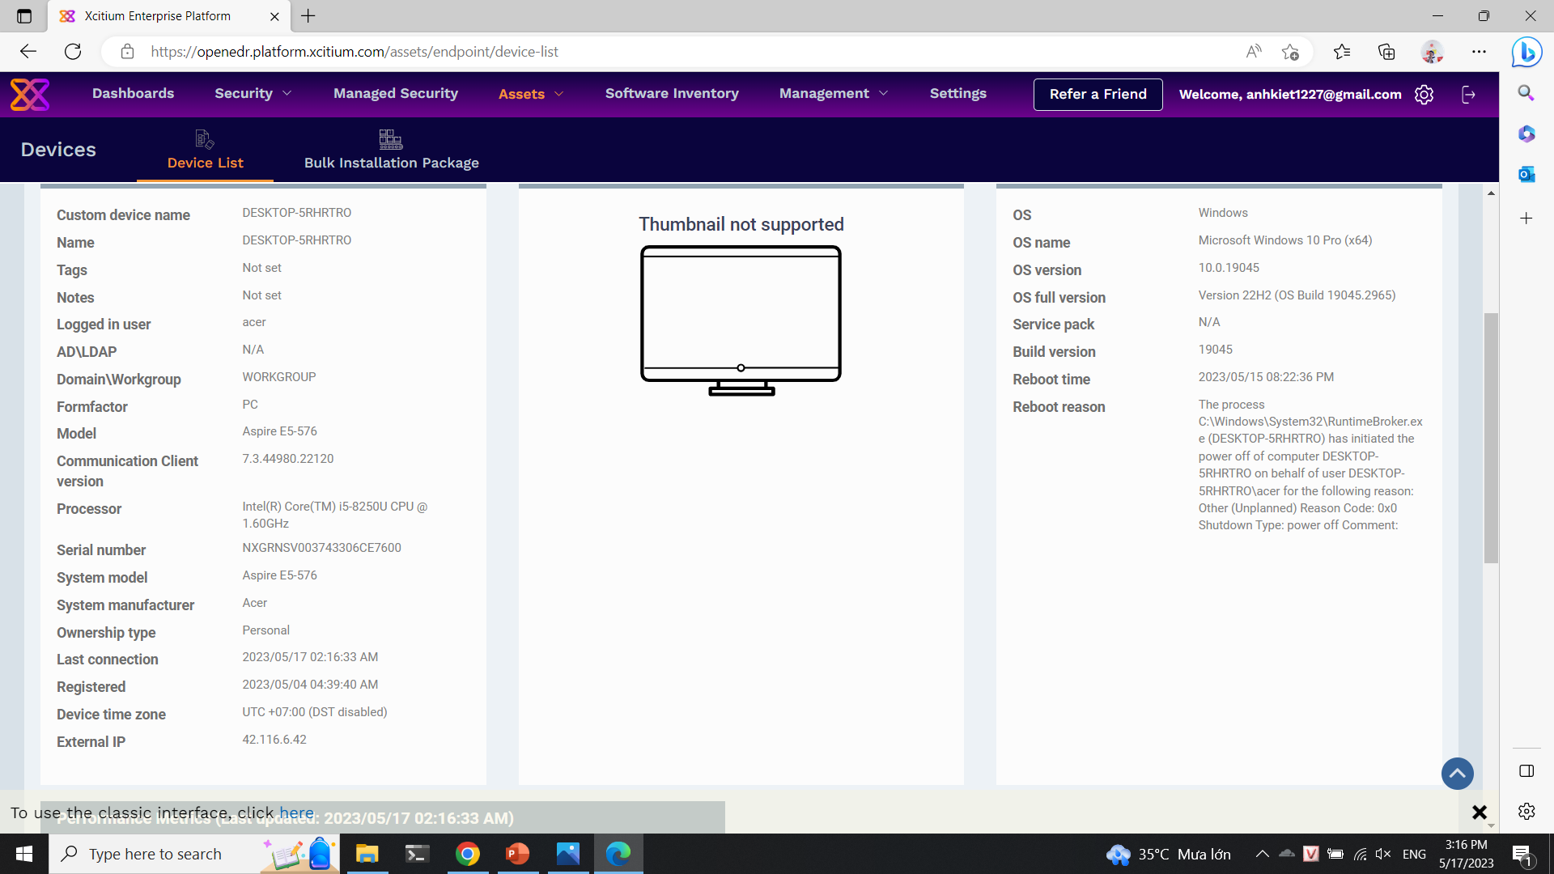
Tool scanning

Slide 13
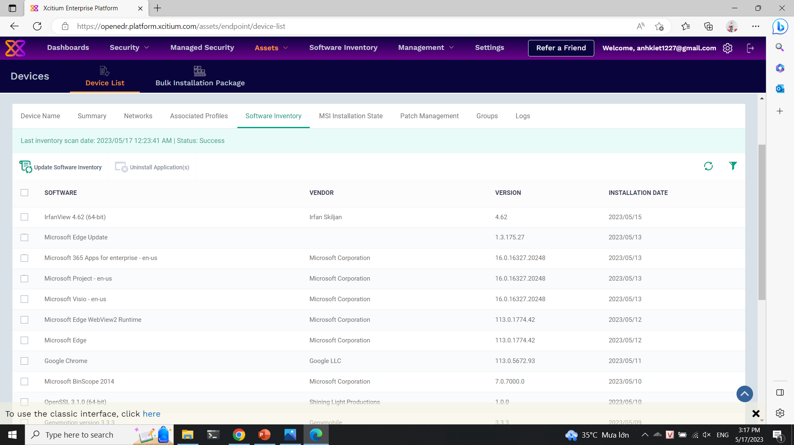
Tool scanning

Slide 14
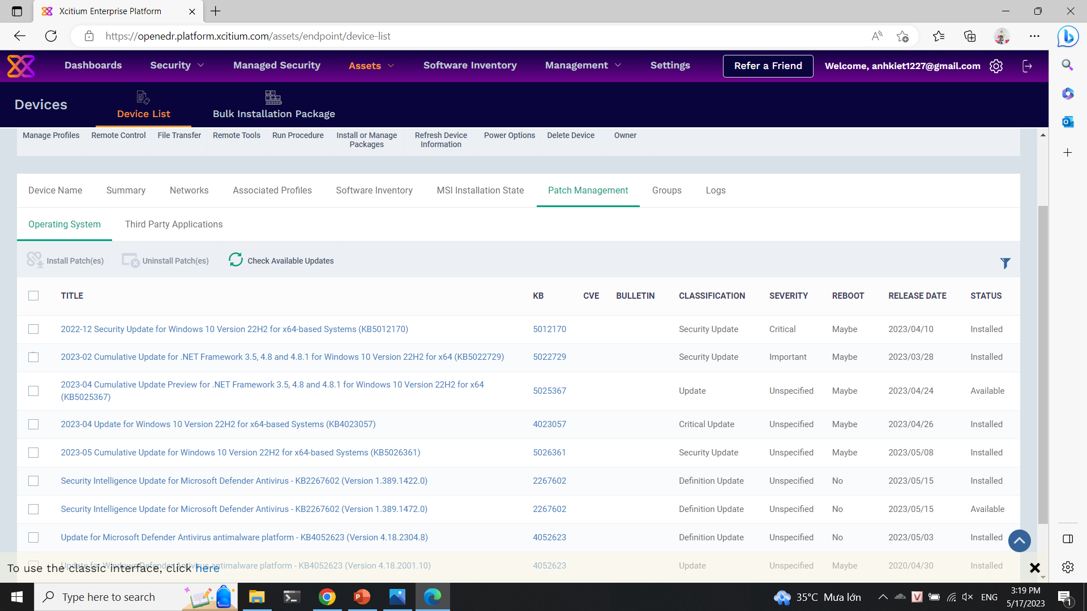
Tool scanning

Slide 15
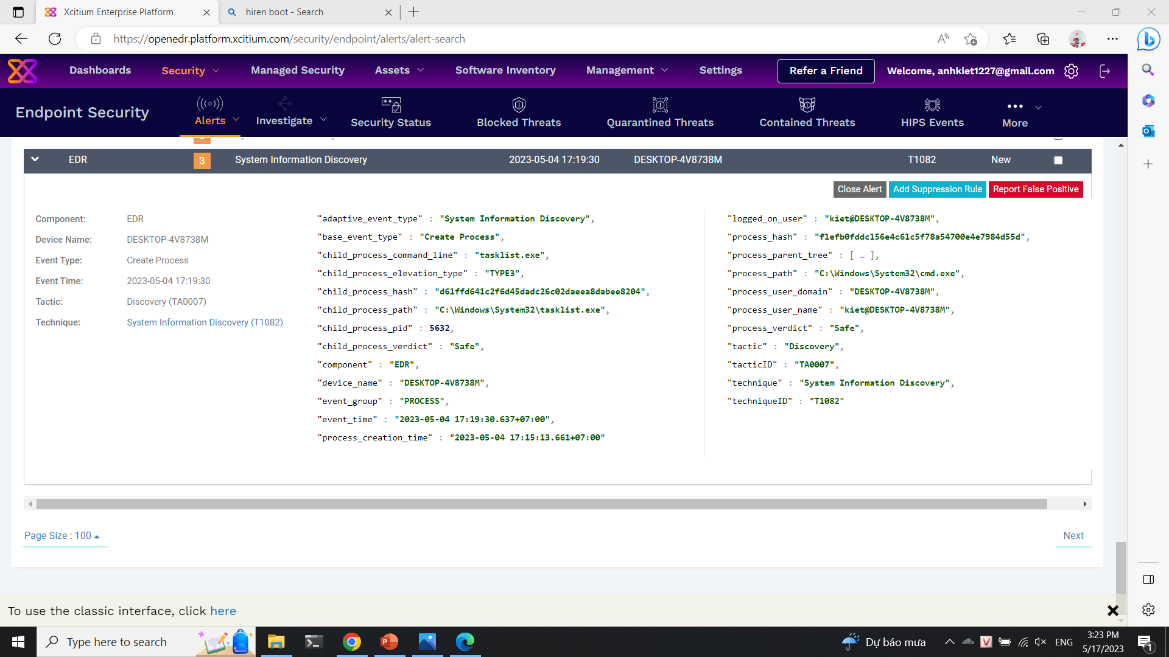
Tool scanning

Slide 16
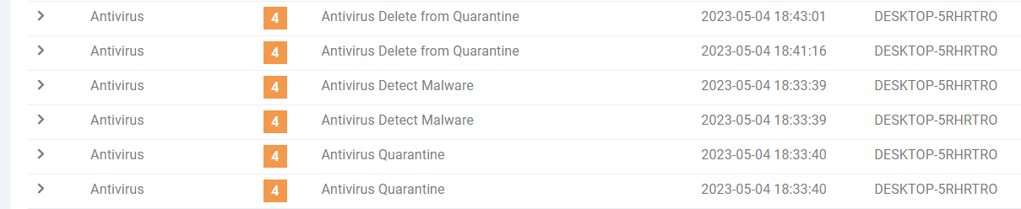
Malware

Slide 17
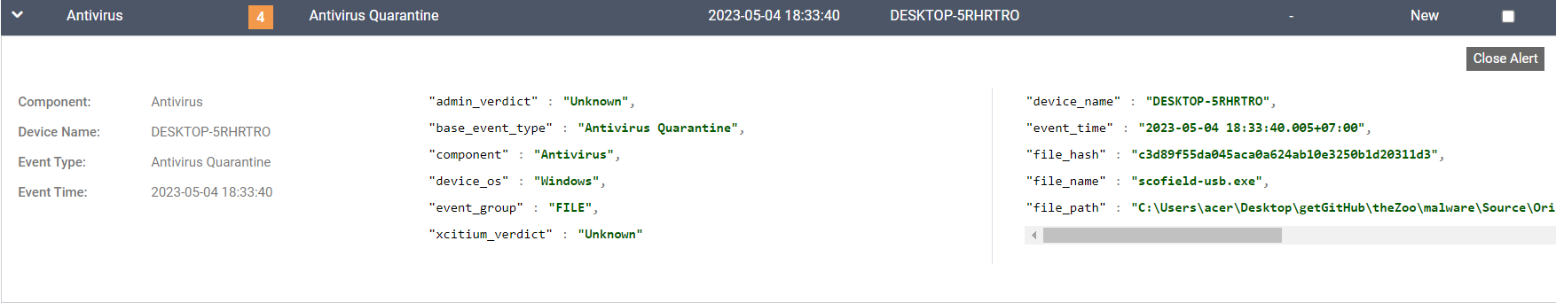
Malware

Slide 18
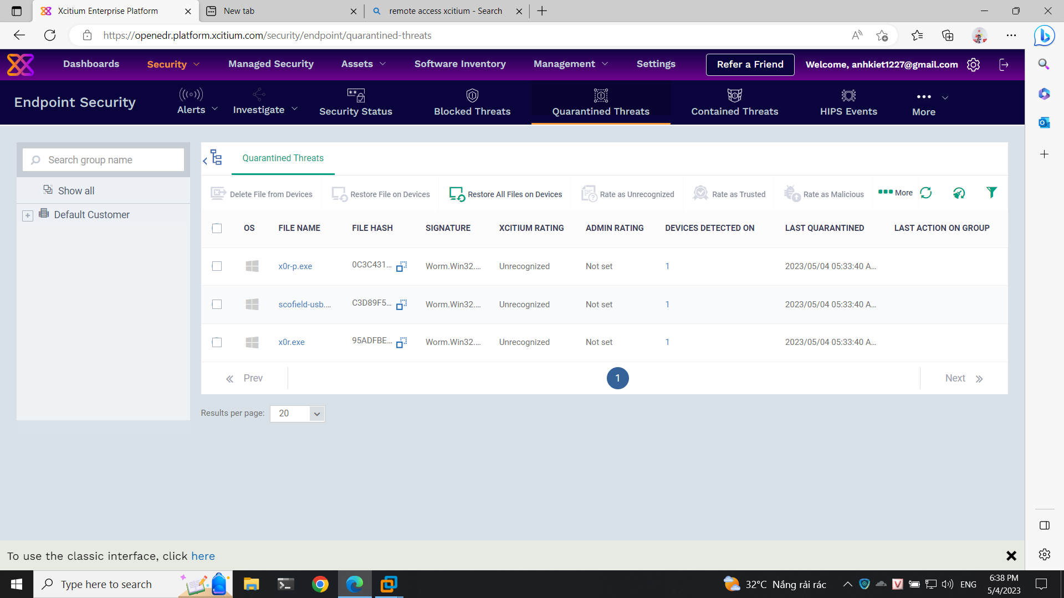
Malware

Slide 19
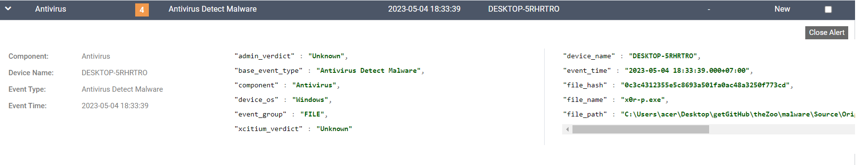
Malware

Slide 20
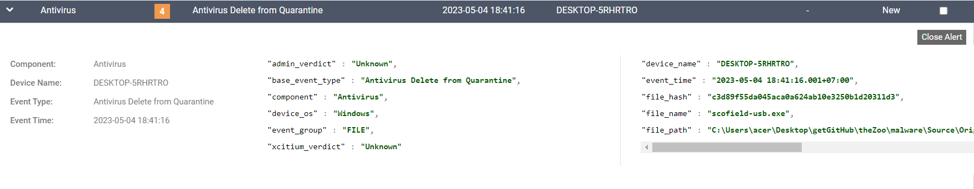
Malware

Slide 21
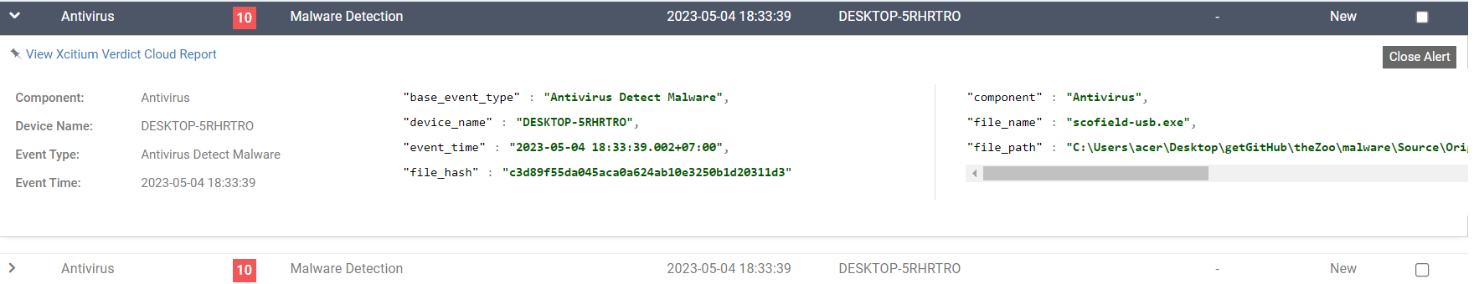
Malware

Slide 22
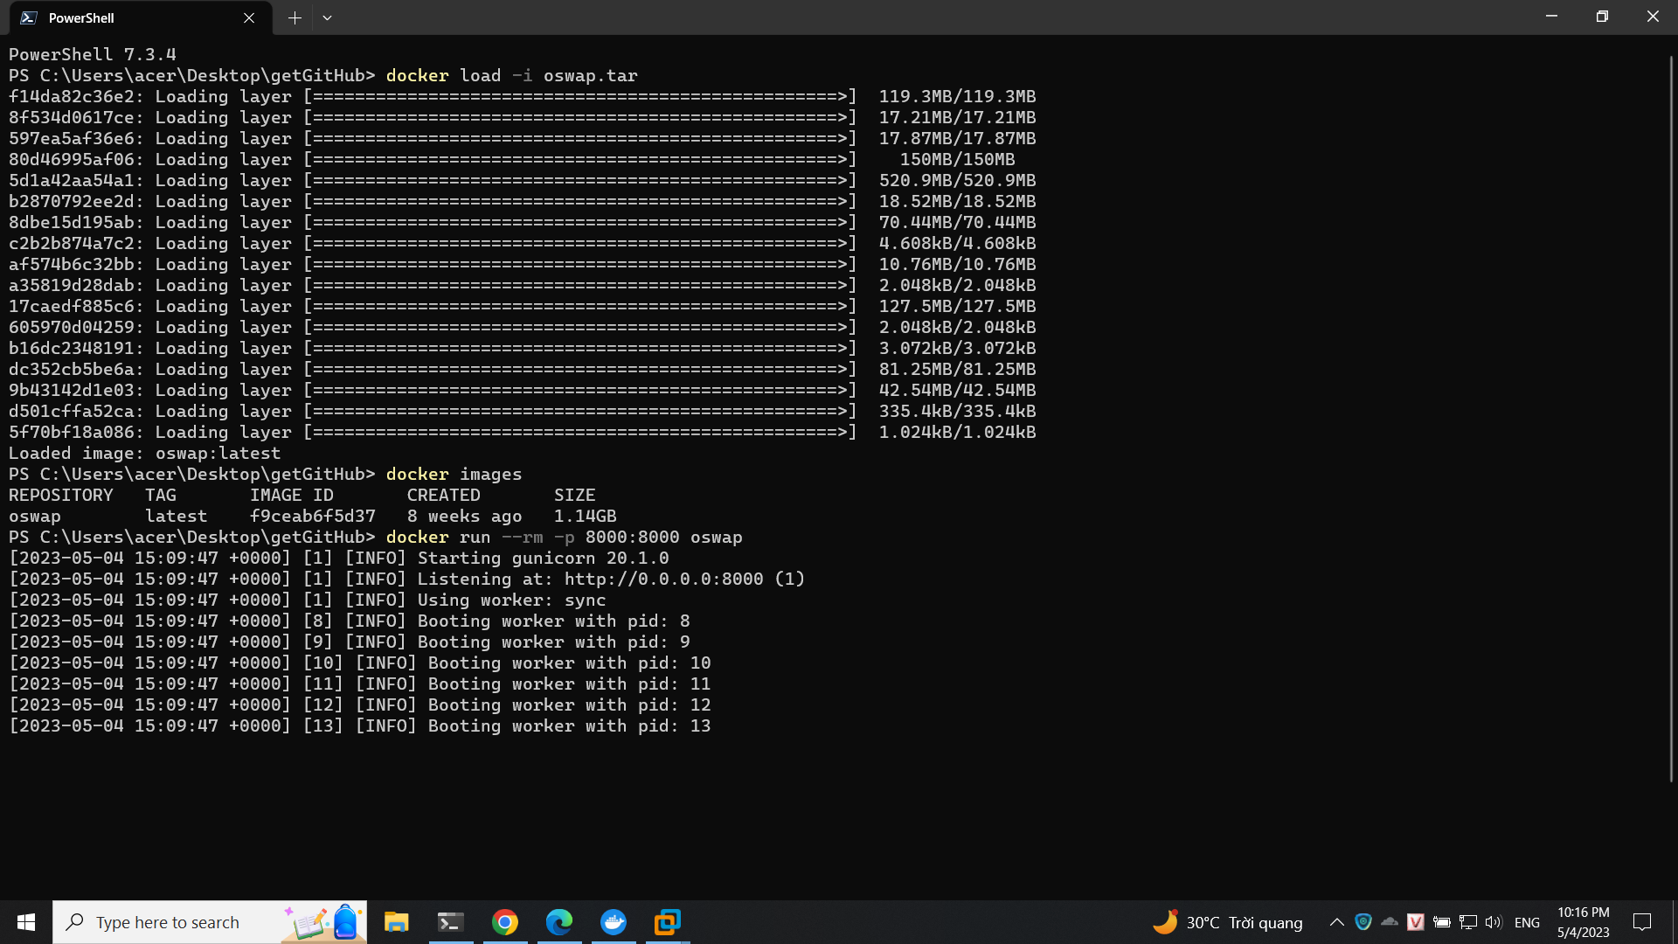
PyGoat – Top 10 OWASP

Slide 23
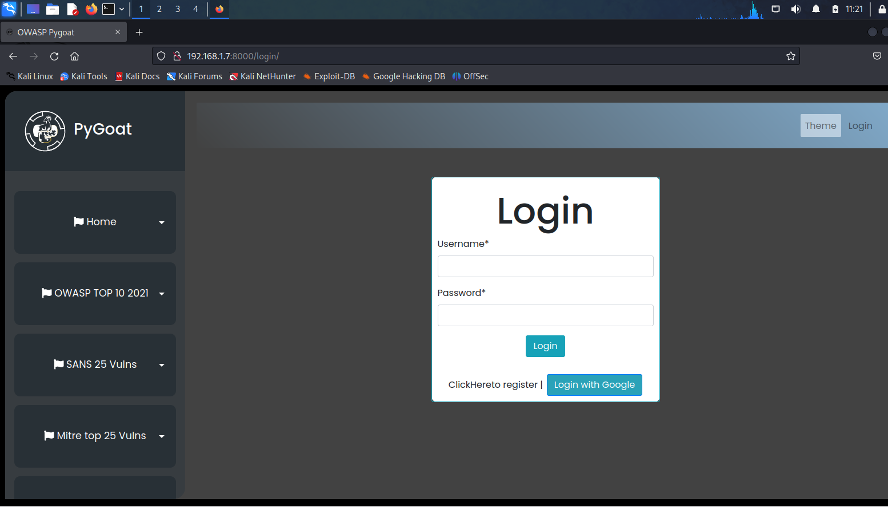
PyGoat – Top 10 OWASP

Slide 24
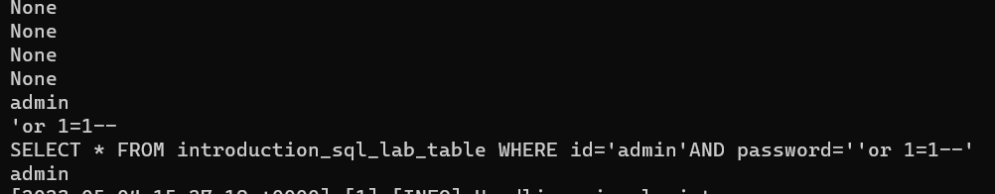
PyGoat – Top 10 OWASP
No announcement on OpenEDR

Slide 25
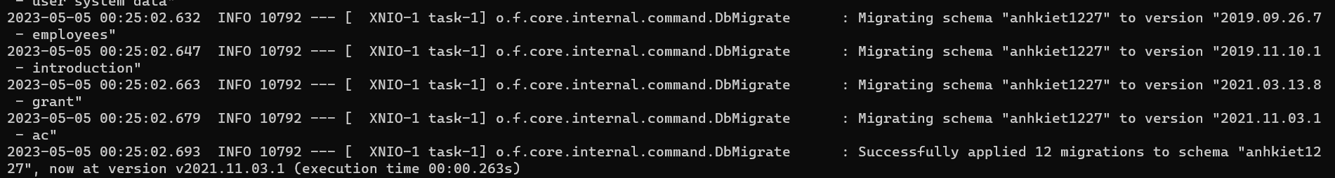
WebGoat – Top 10 OWASP
No announcement on OpenEDR

Slide 26
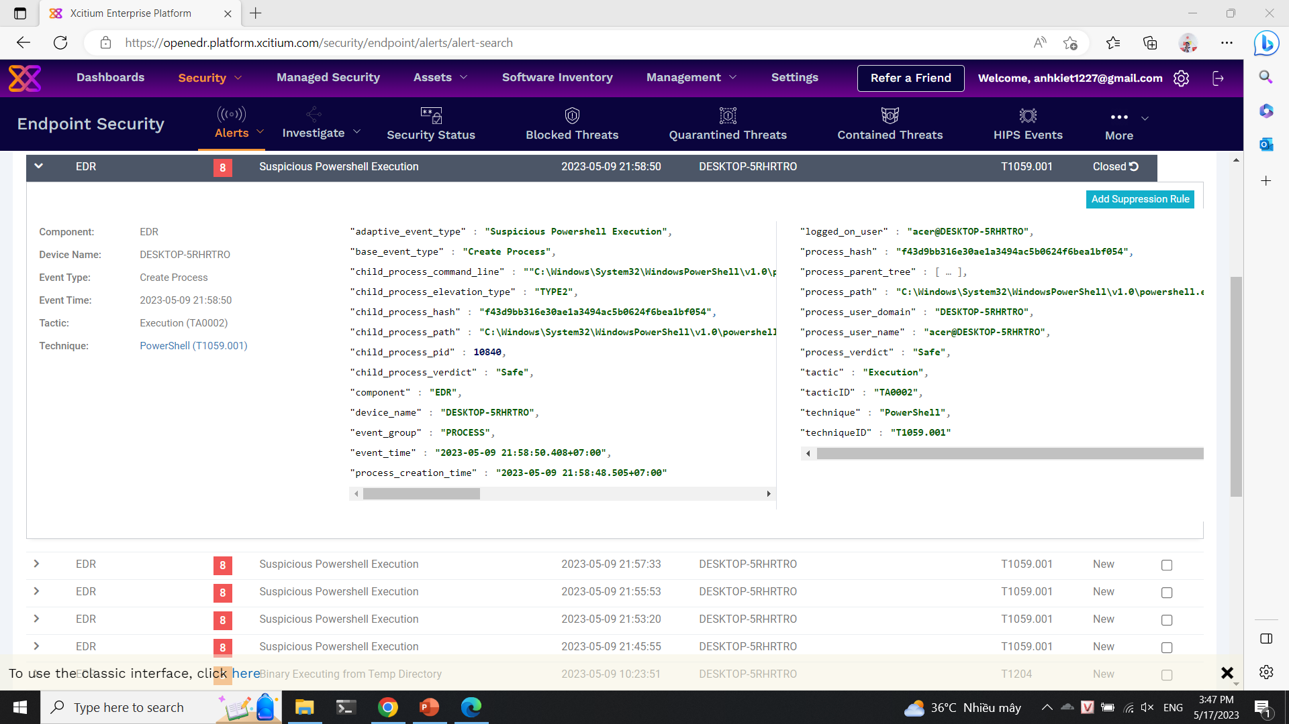
Weakness

Slide 27
02
Registry Spy

Slide 28

Registry Spy
Registry Spy is a free, open-source cross-platform Windows Registry viewer. It is a fast, modern, and versatile explorer for raw registry files.

Slide 29
Requirement installation
(-) Python >= 3.8
Python is a high-level, general-purpose programming language. Its design philosophy emphasizes code readability with the use of significant indentation via the off-side rule.

Slide 30
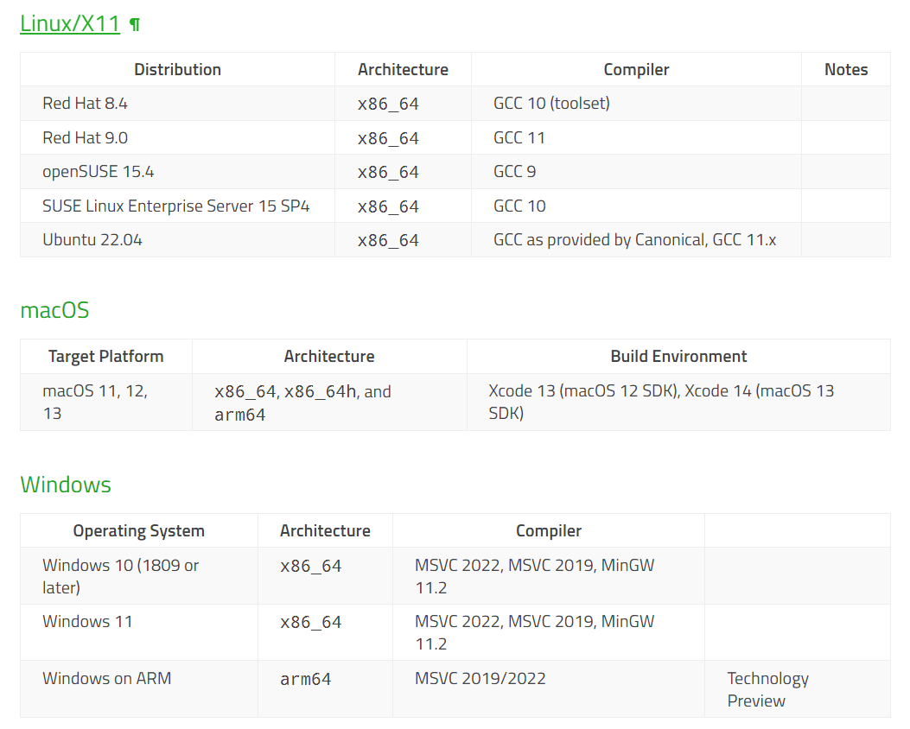
Requirement installation
(-) Operation System

Slide 31
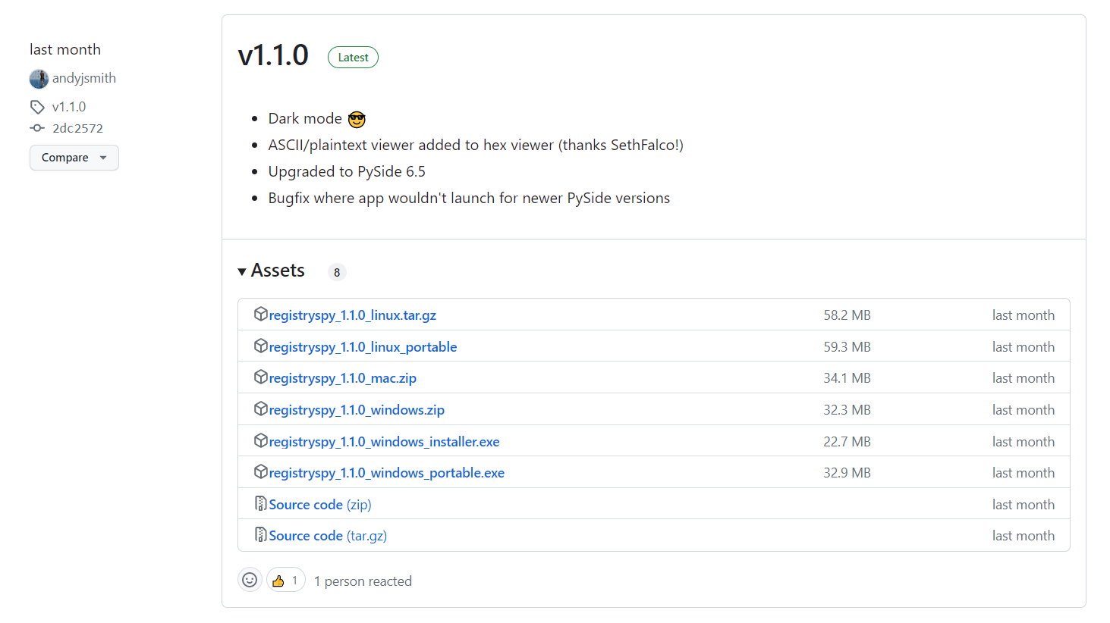
Installation
(-) Version

Slide 32
Installation
(-) Pip pip install registryspy registryspy
(-) Manual pip install –r requirements.txt
python setup.py install registryspy
(-) Standalone pip install –r requirements.txt
python registryspy.py

Slide 33
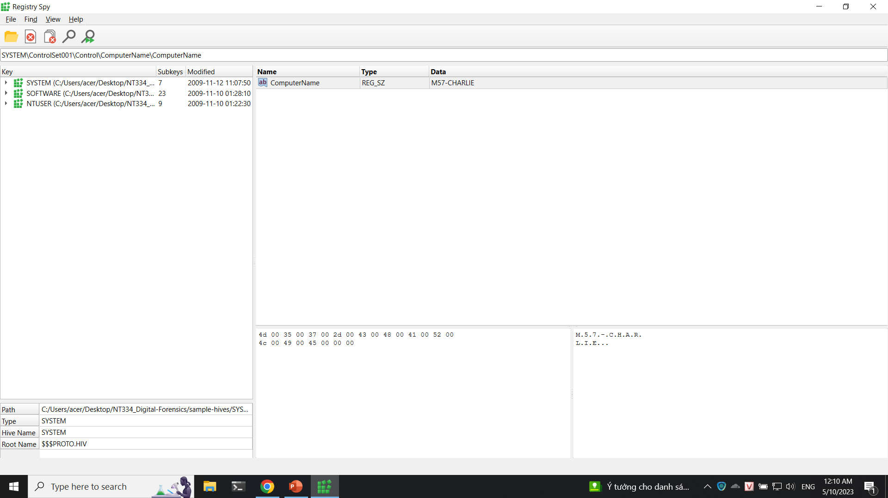
Implemetation

Slide 34
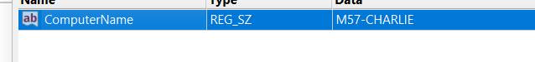
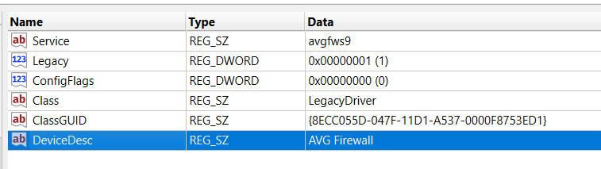
Implemetation

Slide 35
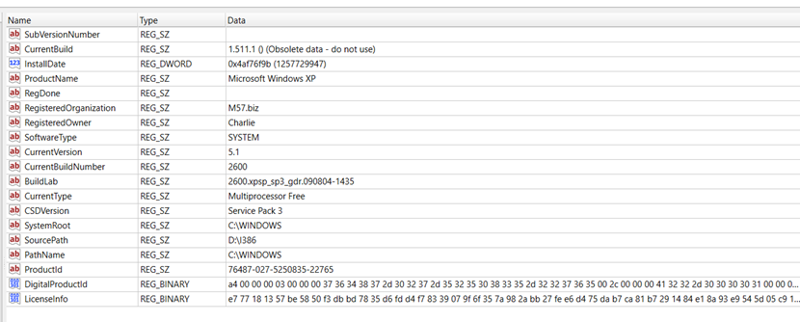
Implemetation

Slide 36
Resources
What is EDR (Endpoint Detection & Response)? Open source EDR® (openedr.com)
GitHub - andyjsmith/Registry-Spy: Cross-platform registry browser for raw Windows registry files

Slide 37
Thanks!
Any questions?
Please, keep this slide as attribution

